Slide 1
IBM Watson Build Challenge
https://www.ibm.com/partnerworld/wps/static/watsonbuild/
Team: New York Power Authority, Starboard (consulting), and RPI (J. Chow, M. Wang, L. Vanfretti, Q. Ji)
Selected in Phase 1; now in Phase 2 competition (due Oct. 2017)
Proposal: develop cognitive solutions to power system control room operation, including alarming processing and control augmentation, by linking cognitive processing of warning messages and technical analysis of various sources of power system data
The cognitive processing part will rely on Watson APIs
Power system data analysis will be based on technical tools developed by the RPI team

Slide 2
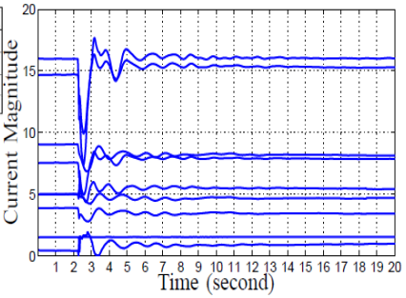





Cognitive Solutions to Power System Control Room Operation
Streaming Data
RPI Data Analysis
Control Room
Missing Data Recovery
Static Overload Testing
Warning Message
Watson Retrieve and Rank
API
Disturbance Recognition
Whether are there events exceeding limits?
Rank the exceeding limits events
Data Science Experience

Slide 3
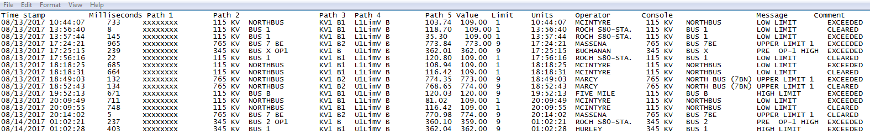
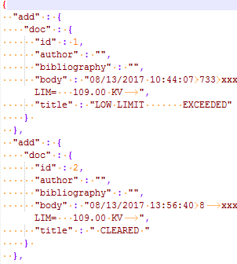

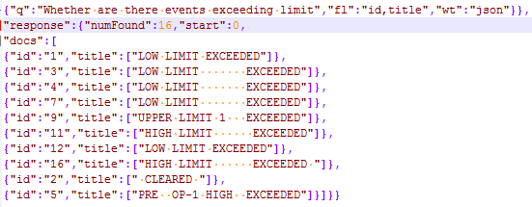
Alarming Processing
Raw warning messages
Document Conversion
Training
of Retrieve and Rank
Testing
of Retrieve and Rank
Question:
Response:

Slide 4
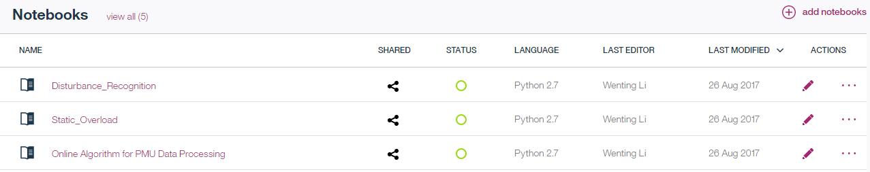

Control Augmentation
Three Data Analysis algorithms are implemented on IBM Data Science Experience
Online Missing Data Recovery
Static Overload Testing
Disturbance Recognition

Slide 5
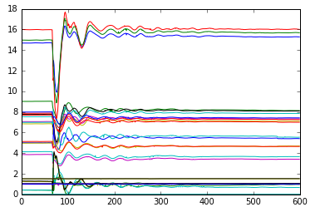
Online Missing Data Recovery
Functions:
To recover the missing data of phase measurement units (PMU) streaming data
Input:
PMU streaming datasets;
Output:
The reconstructed PMU streaming datasets.
Fig. 1 is the reconstructed results.
Fig. 1: Voltage magnitudes and current magnitudes after a dicturbance

Slide 6
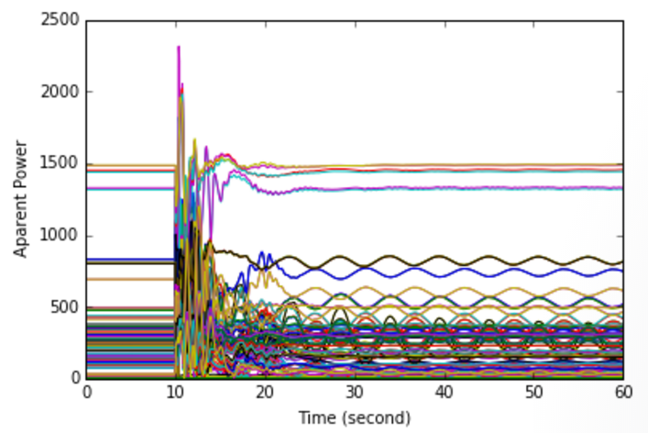

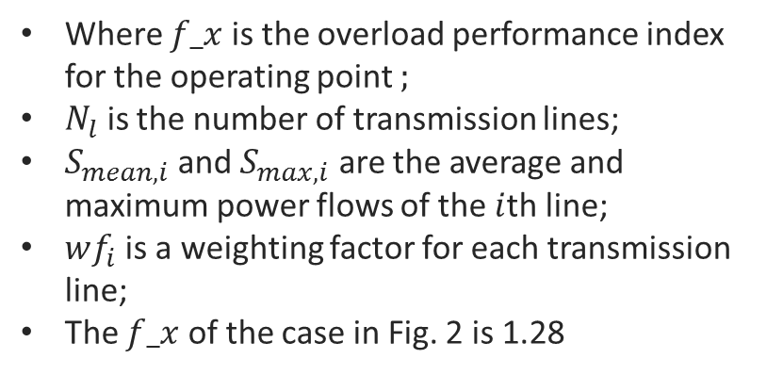
Static Overloading Testing
Functions:
To check whether the operational limit of the transmission lines has been breached.
To check whether steady state is reached.
Input:
Power flow data
Output:
Overload index
Overload index:
$$f_x=\sum_{i=1}^{N_{l}}{wf_{i}{\left(\frac{S_{mean,i}}{S_{max,i}}\right)}^{P}}$$
Where $f_x$ is the overload performance index for the operating point ;
$N_{l}$ is the number of transmission lines;
$S_{mean,i}$ and $S_{max,i}$ are the average and maximum power flows of the $i$th line;
$wf_{i}$ is a weighting factor for each transmission line;
The $f_x$ of the case in Fig. 2 is 1.28
Fig. 2: Apparent power after a disturbance

Slide 7
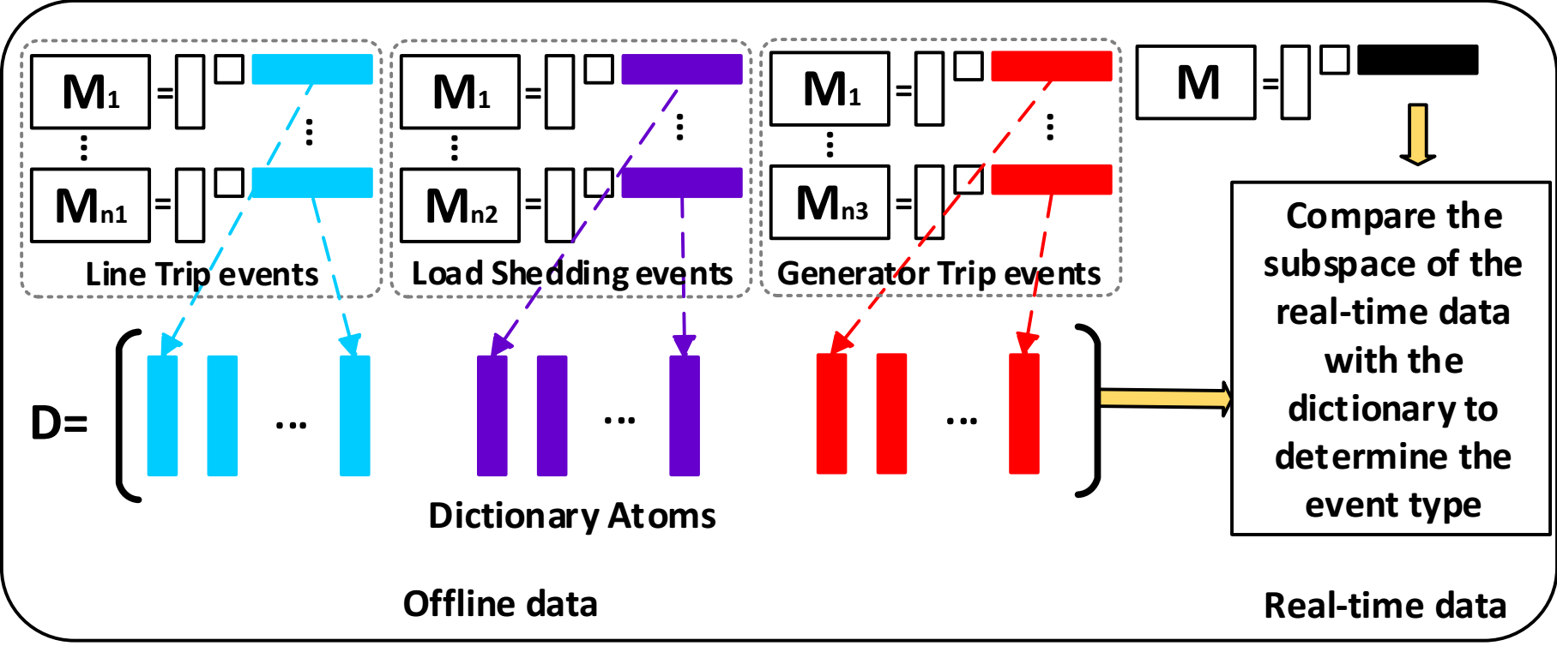
Disturbance Recognition
Functions:
To identify the type of the events by comparing the subspace of online data with the constructed dictionary;
Fig. 3 shows the main idea of our disturbance recognition method.
Input:
Post-event PMU datasets in one second;
Output:
The type of the event.
Fig. 3: Dictionary construction from historical datasets and real-time data identification through subspace comparison

